Slide 2



Digital Magic: Efficient Communication with Customers for Collections
NATALIA SALAS
Finance Consultant @ Algoritmia, MVP AI ERP
MIHA VUK
D365FO Technical Fellow, Docentric

Slide 3
Why Improve Customer Communication for Collections?
  DEFINE A COLLECTIONS STRATEGY!
✨ Avoid manual tasks and the human errors that come with them, to focus on control and data analysis.
✨ Accelerate response time from invoice due date to the first payment reminder.
✨ Easy and quick access to information, for both internal teams and customers.
✨ Enhance the customer experience: A well-designed process conveys professionalism and reduce friction, especially for customers who are willing to pay but haven’t received clear or timely communication.
✨ Scalability, the system remains efficient and manageable even as the customer base grows.
✨ Prioritize and protect the organization’s cash flow

Slide 4


Slide 5


Slide 6
  What do we need in D365FO?
✨Collection Agents (real people)
✨Customer pools
✨Email Templates
✨Invoice Reports
✨Account statements Reports
✨Contact role for collection purposes (optional)

Slide 7
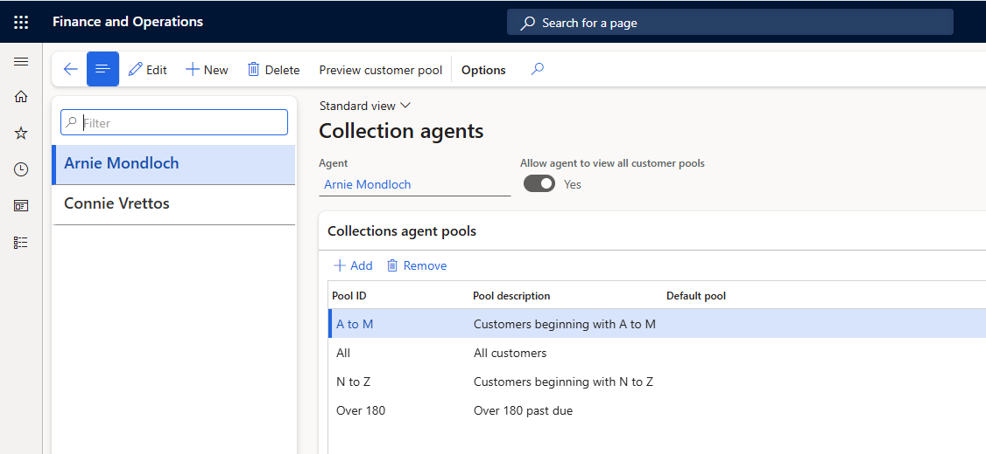
  Collection Agents

Slide 8
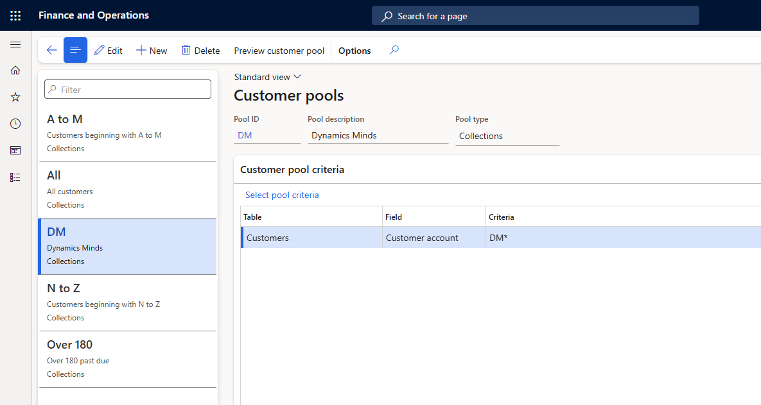
  Customer pools

Slide 9
  Collection letters
✨Formal document sent to a client or debtor to remind or demand payment of an oustanding debt
✨Provides a formal record in case legal action becomes necessary
✨Typically used when the payment due date has passed
✨ Generally contains similar information across different legislations

Slide 10
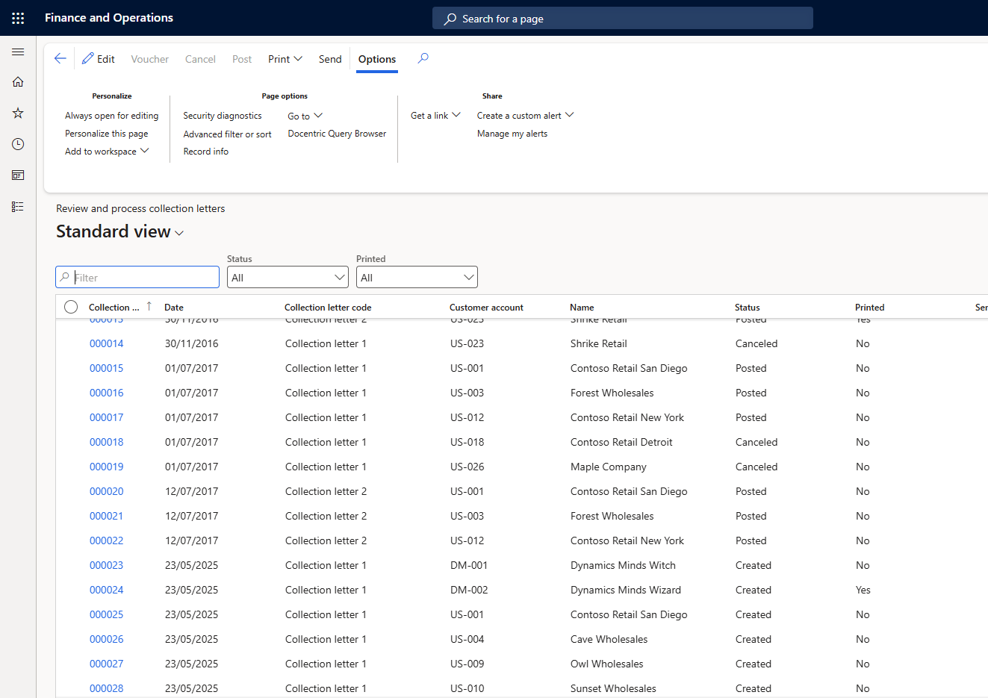
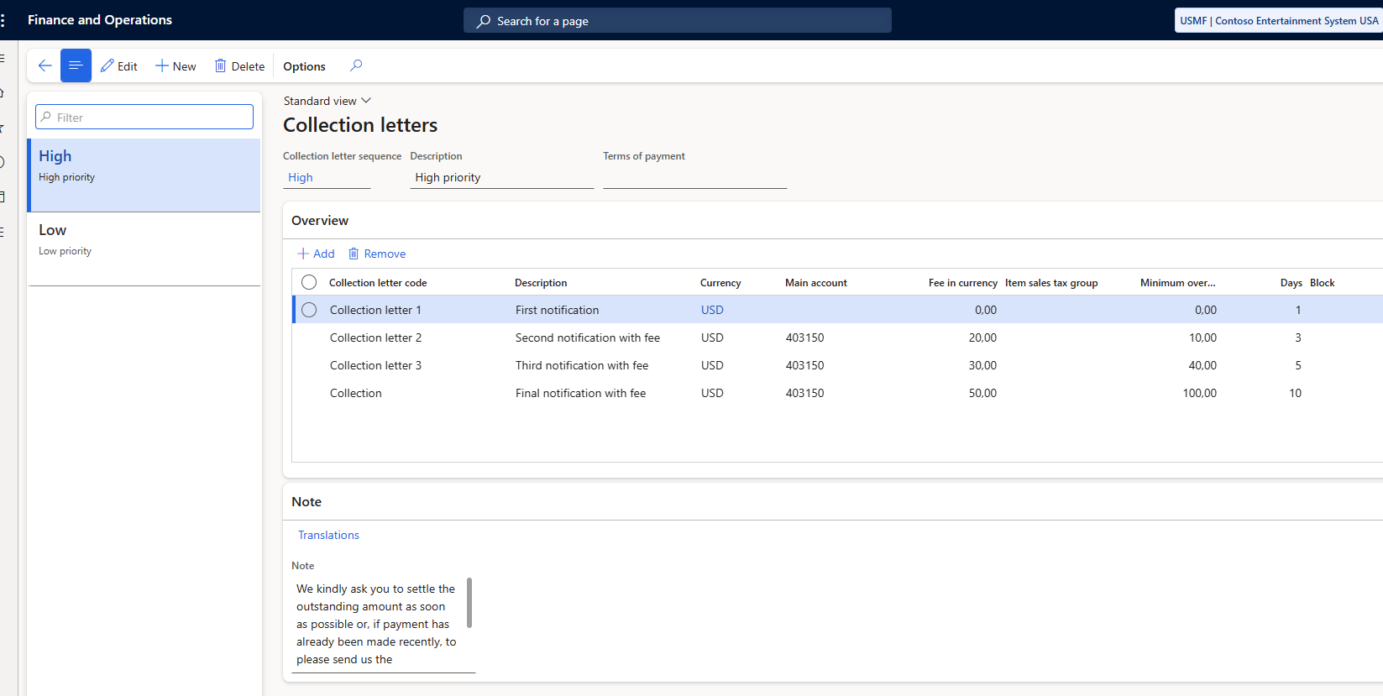
  Collection letters

Slide 11
  DEFINE AN AUTOMATED COLLECTIONS STRATEGY
✨ Collections process strategies that automatically identify customer invoices that require a collection action.
✨ Action types included:
  Email
  Collection activity (Activities related to the tasks and work to do to collect an invoice)
  Collection letter
✨ Each customer pool can only be assigned to one process hierarchy.
✨ In the process hierarchy, the hierarchy rank identifies which process will take precedence.
✨ Business document activity templates setup will depend on the action type
✨ Setup the batch job in the Process automations form
Notes:
DEMO:
Aged balanced > Customer DM-001 > Statement with attached invoices
Activity

Slide 12
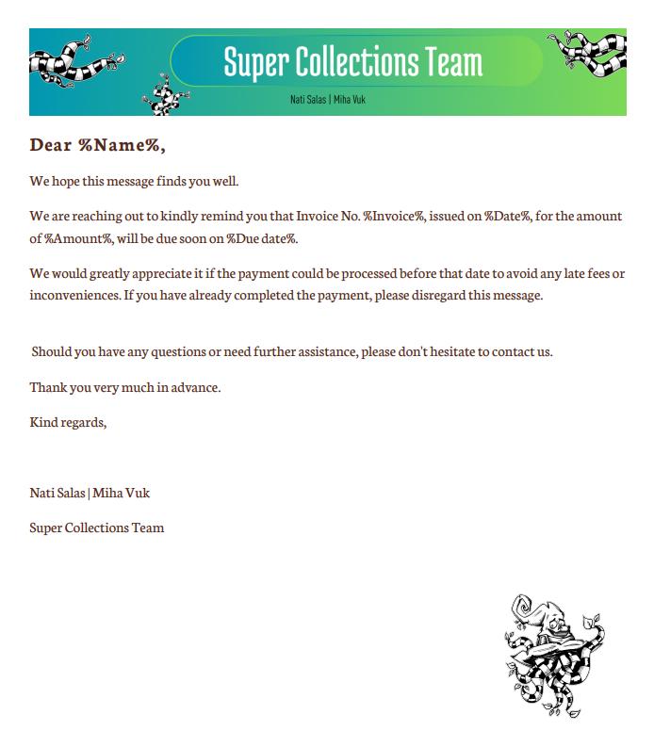
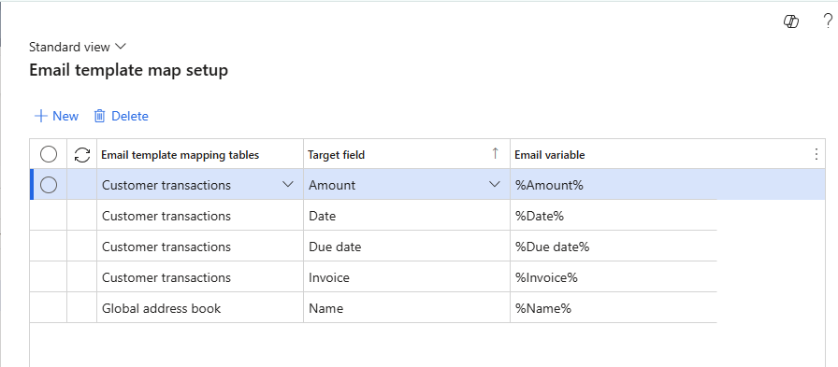
  EMAIL TEMPLATE MAP SETUP
Notes:
DEMO:
Collection process automation (explain standard setup)
Improvements and run the automation

Slide 13
  DOCENTRIC FREE IMPROVEMENTS
For Collection process automation:
✨ Improved email templates
✨ Language independent placeholders
✨ Attached invoices
✨ Send test email
✨ Email processing

Slide 14
Finance Agents in Outlook
Supports collections processes:
✨ Easy access to customer data from ERP
✨ Creates activities (invoices status) from Outlook
✨ Quick email writing with document attachments:
  Invoices
  Account statements
✨ Only SSRS reports are currently supported (ER and Print management not yet)

Slide 15
Summary
✨ Invoices
✨ Customer account statement
✨ Collection letters
✨ Collection process automation
✨ Finance Agents in Outlook
✨ Improvements
  Attached open Invoices
  Better email templates
  Available in Docentric Free Edition

Slide 16

QUESTIONS?
NATALIA SALAS
natisalas.com
linkedin.com/in/Natalia-salas-d365f
MIHA VUK
miha.vuk@docentric.com
linkedin.com/in/mihavuk

Slide 17

THANK YOU!

