Slide 2
Meet D365FO Free Community Tools

Slide 3


Jovica Živković
Technical Consultant, Docentric
Meet D365FO Free Community Tools
Miha Vuk
Technical Fellow, Docentric

Slide 4
Agenda
D365FO Free community tools overview
Productivity Tools by Docentric
  Table, Label and Query browser
  Batch job alerts and export log
Summary
Notes:
We will start with overview of some Free community tools/solutions that you can use in your D365FO environment.
Some of them we have installed in our env and will demonstrate some features in live.
However, that is just our selection from many available free tools and their features.

Slide 5

We would like to hear from you!
How many of you have tried at least one FREE tool for D365FO?
If yes, which ones?
Tools:
AOT Browser
XPP Tools
D365FO.tools
Table browser caller
Docentric Free edition
D365FO Admin Toolkit
Elysian2 E-attach Free edition
AMCS Lite Free Accounting Automation
. . .
Groups
Embedded D365FO tools
External Admin tools
Browser extensions
Developer tools
Notes:
These tools are created by passionate experts, MVPs, and community contributors, and by using them thoughtfully and with care we can speed up our work and be more efficient.
We've categorized some of them into four groups, which are as follows:
Embedded D365FO tools – are accessible from menus from your D365FO client, part of environment
External Admin tools – outside of the D365FO, these are some power shell scripts
Browser extensions – part of user browser that each user can install
Developer tools - part of VS
Whether you're a developer, consultant, or administrator, there's something here for you. So, let’s dive in and explore how these tools can make your work easier, faster, and more efficient.

Slide 6
Installed into D365FO environment as custom code via Model, Package or Project.
Embedded D365FO tools
Notes:
They are inside your environment, and you treat it as any third part solution or your custom code.

Slide 7

AOT Browser by Arbelatech (Argano)
Browse AOT objects from the D365FO web client.
Search/Filter object by AOT name, labels or type
Open table/view in table browser
View source code
View extensions inline
Open from form personalization screen
https://arganollc.github.io/aotbrowser/
Notes:
In Dynamics AX 2012 and earlier it was possible for power users to be able to open and browse the contents of the AOT (Application Object Tree) from the UI. This functionality was removed in Dynamics 365 for Finance and Operations as all development is now done in Visual Studio. With the AOT Browser it is now possible to browse the objects in the AOT from the D365FO web interface.
It is necessary to populate the list of AOT objects after installing AOT Browser. This is achieved by clicking the Populate AOT objects button. It is recommended to run this as a batch job as it can take several minutes to complete. It is also recommended to schedule the batch job with recurrance so that the list is up-to-date with all of the objects in the AOT.
ViewExtensions inline/separate note > When enabled, extensions will be shown in the tree where they belong. They are bolded and have the name of the extension they belong to in parenthesis after the name. When the toggle is disabled, the extensions show up as a separate node at the bottom of the tree.
ViewSorceCode > This feature uses a disk based metadata provider that reads the source code directly from the source XML files in the metadata directory. Enabling this button is only supported in environments that contain source code, such as DevBox or UDE.

Slide 8
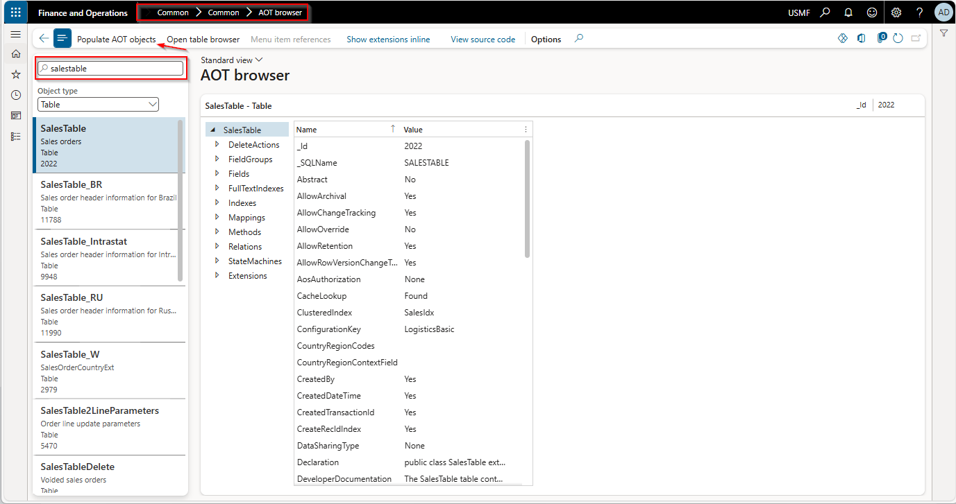

Slide 9
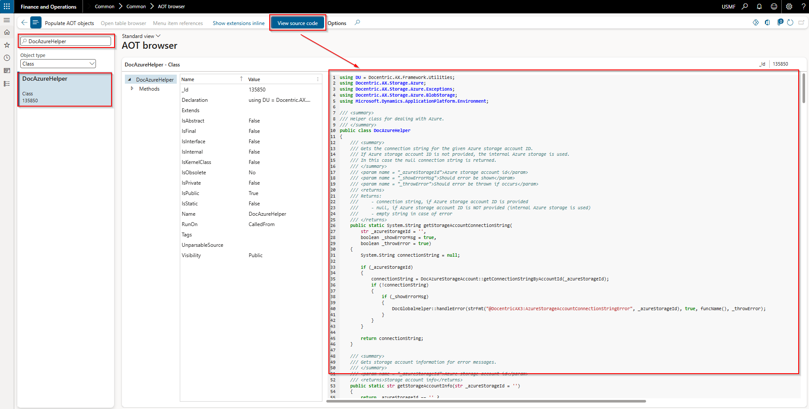

Slide 10
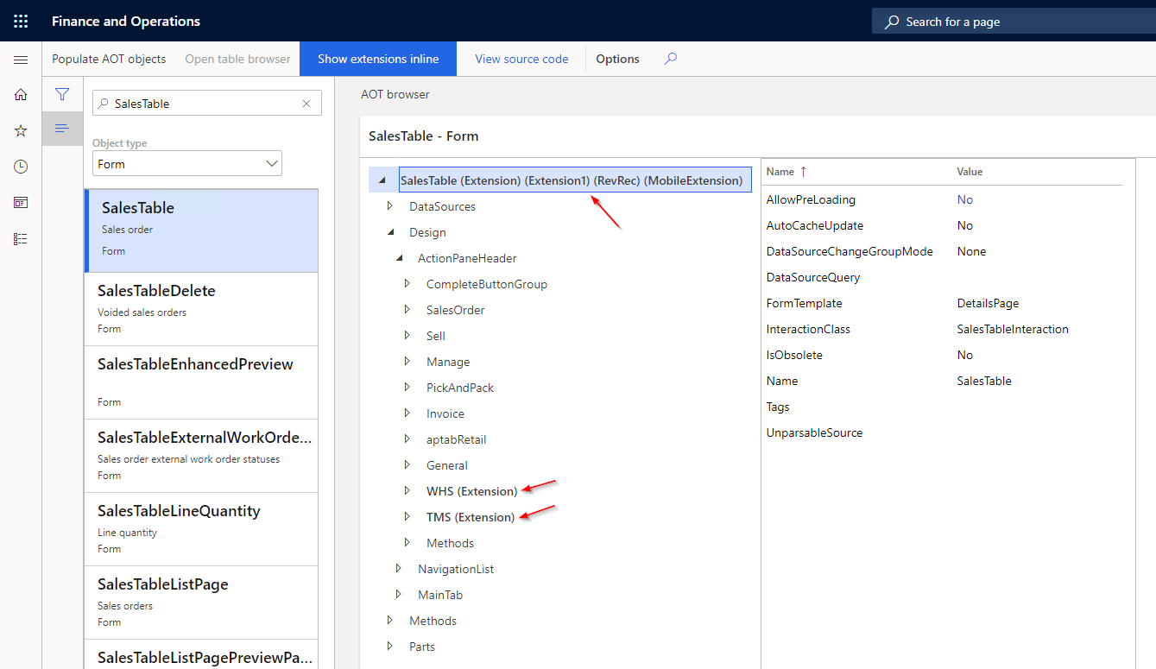

Slide 11
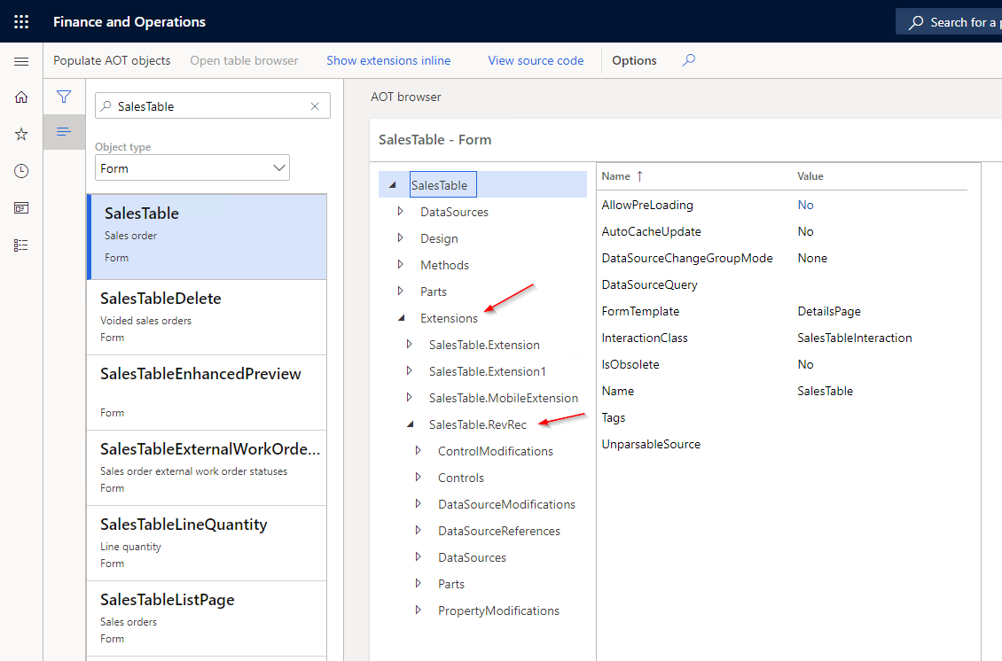

Slide 12
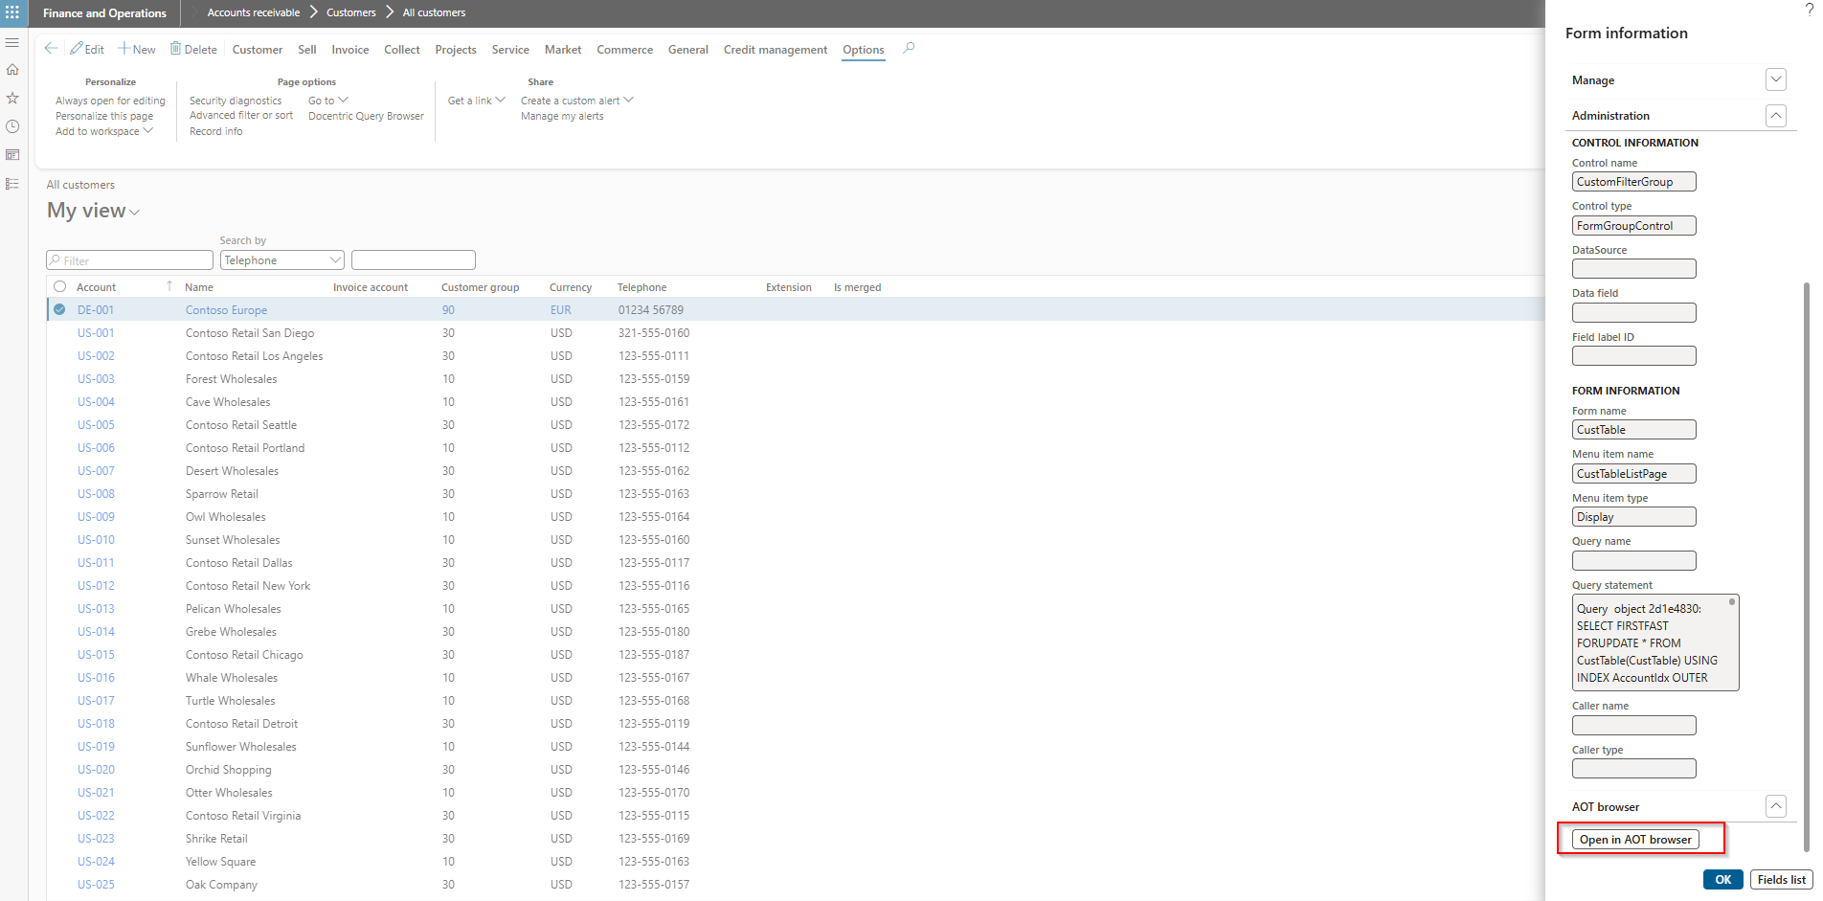

Slide 13
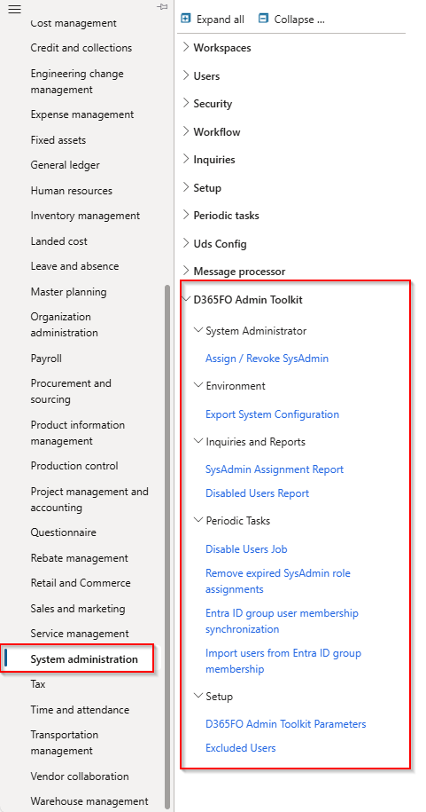
D365FO Admin Toolkit by Alex Meyer
Improves the user experience for administrators of the D365FO.
Assign / Revoke SysAdmin Access
SysAdmin role assignment / revoke reporting
Disable Users job
Disabled Users Report
Excluded Users
Export all role access to CSV
Export System configuration
https://github.com/ameyer505/D365FOAdminToolkit
Notes:
Alex – one of the top person for D365FO security things (expert in D365FO security)
Its purpose is to help, simplify and improve the user experience for administrators of the D365FO application
Be more efficient while doing administration of the D365FO
It is based off the GitHub project located at: https://github.com/ameyer505/D365FOAdminToolkit
Assign/Revoke SysAdmin - This feature allows for the assignment or revocation of the SysAdmin role from a user without needing elevated access.
If the ‘Show Reason Dialog for SysAdmin’ configuration is enabled, during the assignment of the SysAdmin role you will be prompted with the dialog where you provide a ‘reason’ explanation on why you are elevating this user’s access to SysAdmin. Any value provided will be visible on the SysAdmin Assignment Report. If the ‘SysAdmin Expiry’ feature is enabled, you will also see a ‘End Date / Time’ option on this form where you can set the date and time the user should have their SysAdmin role removed.
SysAdmin role assignment / revoke reporting > This feature allows for the reporting of when the SysAdmin role is either assigned or revoked for a user.
This report will capture anytime the SysAdmin role is assigned to the user whether it comes from the D365FO Admin Toolkit functionality, or through a standard user role assignment process within D365FO.
Export System configuration - This feature will export system data from a D365FO environment. You can then use a separate comparison tool to compare data / configurations between D365FO environments, available here: https://github.com/ameyer505/D365FOEnvironmentComparisonUtility
When executed, a zip file is created and downloaded:
Disable Users job > This feature will automatically disable users that have not logged in for a set number of days.
The process of disabling users will not process users who are assigned the SysAdmin security role.
Before the executing you have the ability to set the number of days to utilize to determine if a user should be disabled or not based on the last time they logged in.
This job can also be scheduled as a batch job to run automatically.
Excluded Users > This functionality allows you to specify certain users from not being processed as part of the disable user feature.

Slide 14
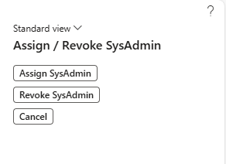
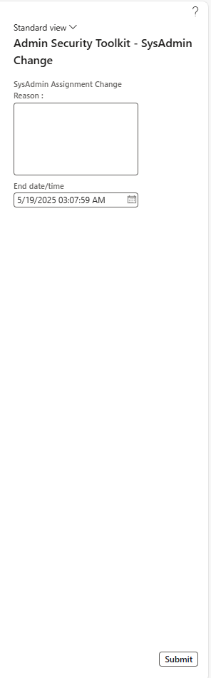

Slide 16

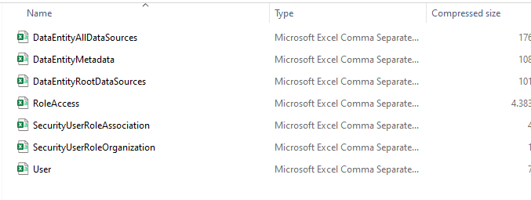

Slide 17
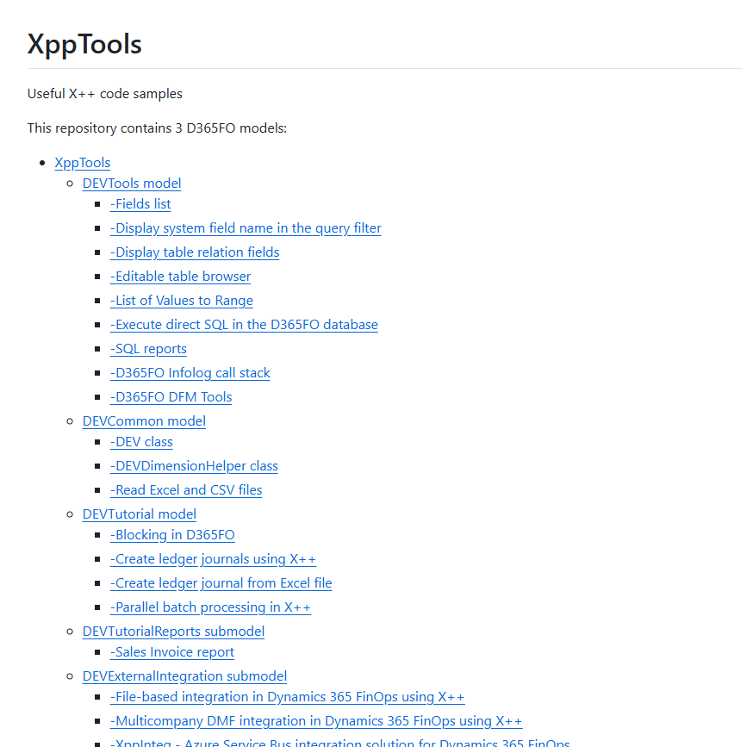
XPP Tools by Denis Trunin
Collection of X++ tools, code samples, integration solutions and tech tutorials.
Execute direct SQL in D365FO database
Editable table browser (extension)
Fields list
Infolog call stack
List of values to range
https://github.com/TrudAX/XppTools
Notes:
This is a collection of advanced X++ tools, offering code samples, integration solutions, and technical tutorials.
'Execute direct SQL’ >is a simple form that allows one to write and execute direct SQL from the browser on the D365FO database. As direct SQL execution is quite a dangerous operation, I also added a second tab to this form that logs all executed commands, so you can always check who used it. User Admin should be included to DEVSQLQueryExecute role
Editable table browser > Extension for the standard D365FO table browser that allows root navigation and editing for non-development environments. https://usnconeboxax1aos.cloud.onebox.dynamics.com/?cmp=USMF&mi=DEVSysTableBrowser&tablename=custgroup.
InfoLog call stack > that saves stack traces for every infolog message. It allows, in some cases, understanding the source of the message without debugging.

Slide 18
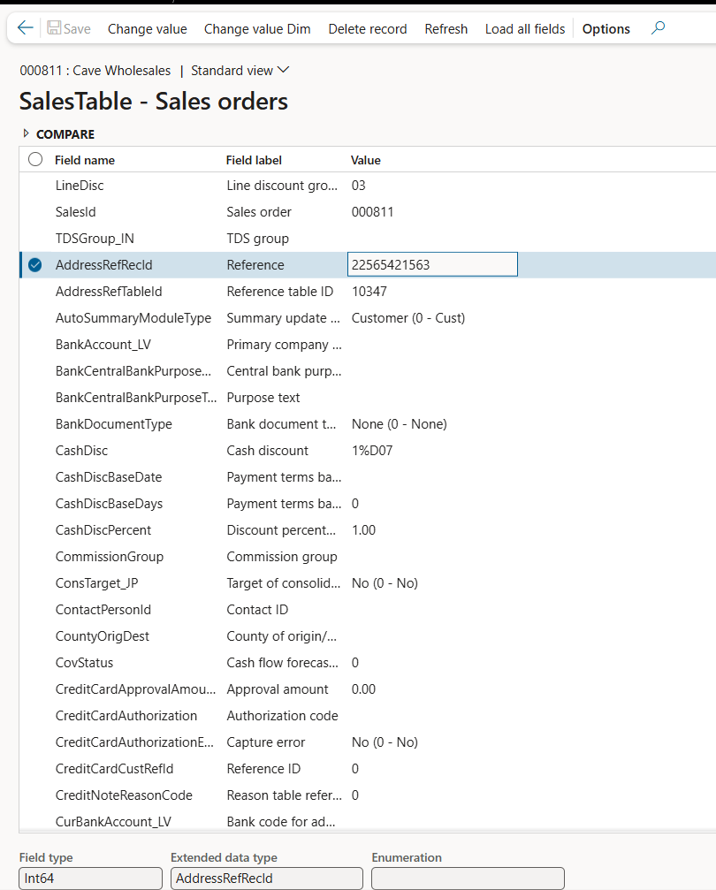
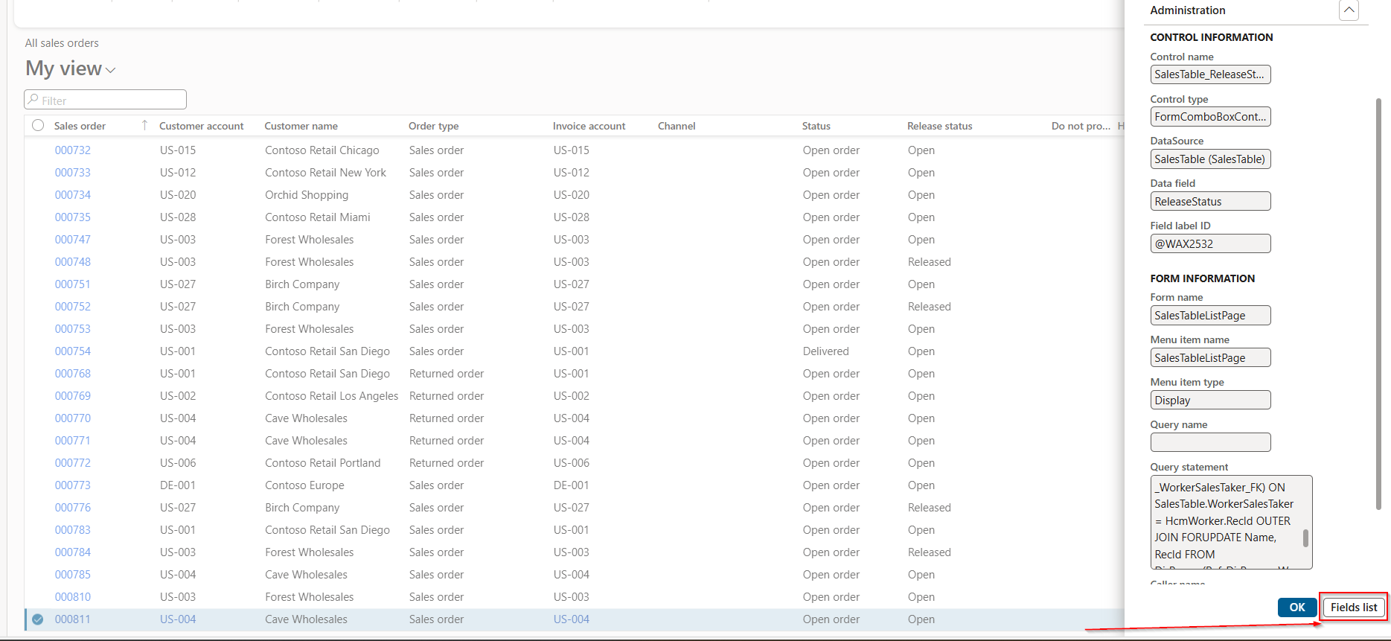
Notes:
Fields list form is an extended version of the standard Show all fields form with the additional features such as displaying all fields with the extended information, comparing and editing.
Table fields that have Visible = false will be shown while through the table browser will not be able to see these fields
You can update or delete the current record with or without validation(it is not what you should use on test/prod data, but sometimes it can be useful during the development or debugging process)

Slide 19
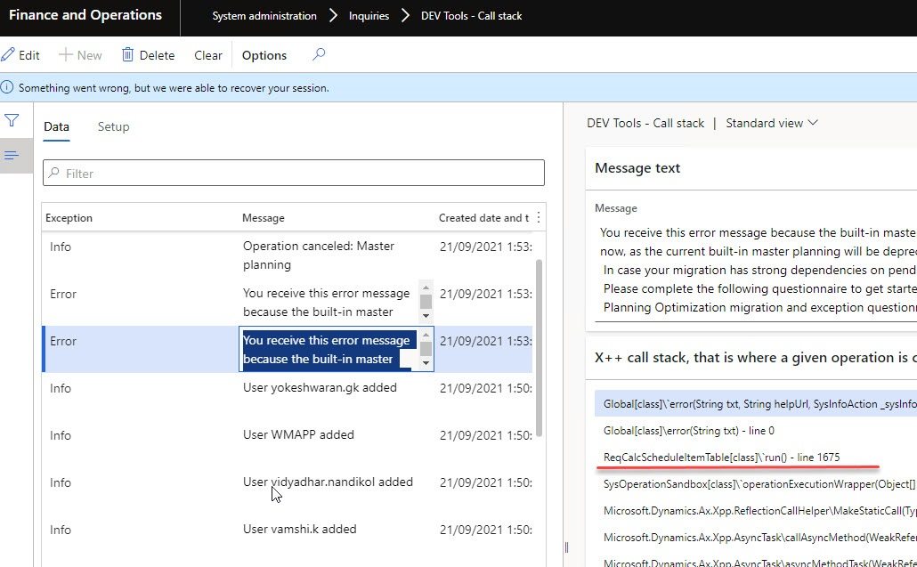

Slide 20
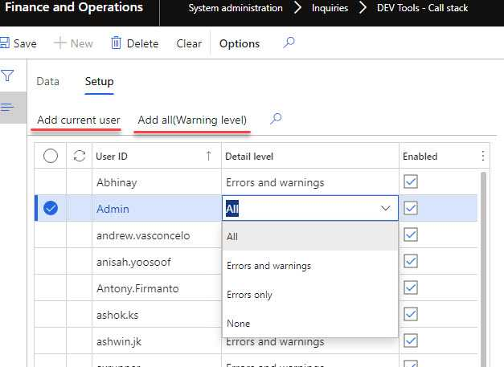
Notes:
Setup tab that allows setting up a logging level per user. You can also setup logging to all users for Warning and Error messages

Slide 21
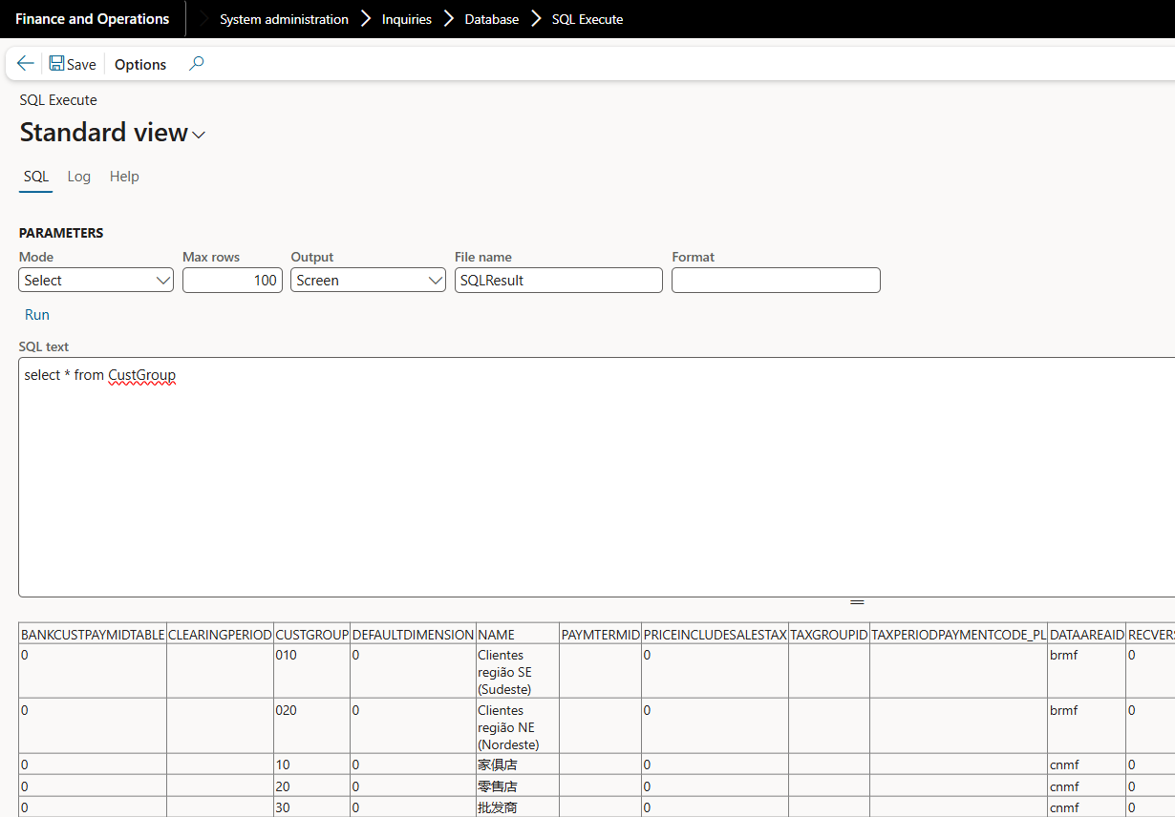
Notes:
Support SELECT, UPDATE, DELETE statements

Slide 22
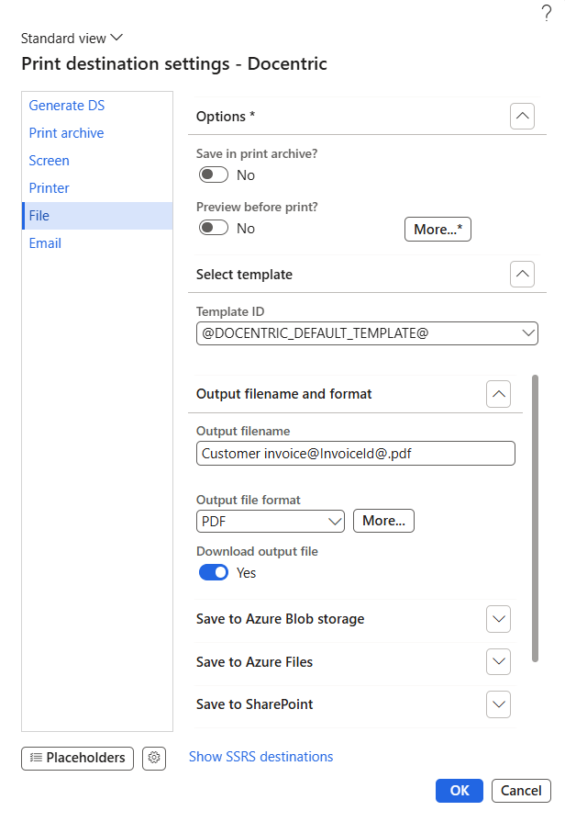
Docentric Free Edition
Improves various system frameworks,
with reporting being just one of them.
Improved Print destinations
  Screen, Email, File, Printer, Print archive
Improved Print archive
Document management attachments
Email templates for Alerts and Workflows
License plate labels
Alerts ++
Print management improvements
Table, Label, Query browser
https://ax.docentric.com/free-edition/
Notes:
It improves various system frameworks, with reporting being just one of them.
The original purpose of Docentric Free Edition was to improve emailing, printing, archiving and distribution of built-in SSRS reports, such as invoices and orders, by enabling Docentric improved print destinations for SSRS reports. Over the years, we have added other free improvements, including enhancements to Print management, Alerts, Email templates, Attachments, License plate labels and more.
Show Print destinations – Use Placeholders (Standard and Custom) provide dynamic content, for example Personalizaed Email subject and body, Dynamic folder names, Meaningful file names
Improved Print Archive > When printing reports you can choose to archive them at the same time. Built-in Print archive is pretty limited – you can search reports only by their caption and view them as PDF. We added following features : Search by report name, document ID (e.g. Invoice ID), source table ID (e.g. Sales/Purchase ID), Customer/Vendor account number, etc. , Search by report parameters and Print archive note, which can be configured per report execution. Instant document priview, Download zipped, merged or encrypted report files.
License plate labels – Simplified Document Routing setup, Test the Document Routing setup, Reprint from D365FO.
Email templates for Alerts and Workflows> We have improved standard System and Organizational email templates that can be used in WF and added support to use them in the Alerts. HTML Email body editor, Placeholders overview and picker
Print management improvements > Print management data entity for export print mgmt. from PROD to UAT, Save button etc.
It’s not just the product we deliver for free – there are also many POCs and Custom Solutions, all of them working on top of Docentric Free Edition and available on our website or on request.

Slide 23
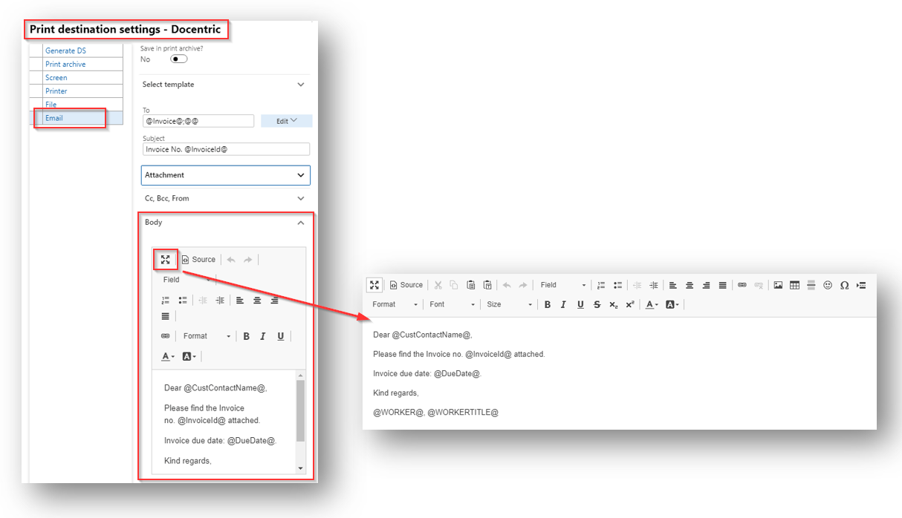
Notes:
Advanced HTML editor for formatting the email bodies directly within D365FO.
Placeholders that can be used in every print destination field, for example: To, Subject, Attachment name, Email body etc. You can pick the placeholders from a list of placeholders available for the current report.
Possibility to specify the email message From field which will be used instead of the user’s email address
Possibility to specify the email message Bcc field.
Possibility to email the reports without the attached output file.

Slide 24
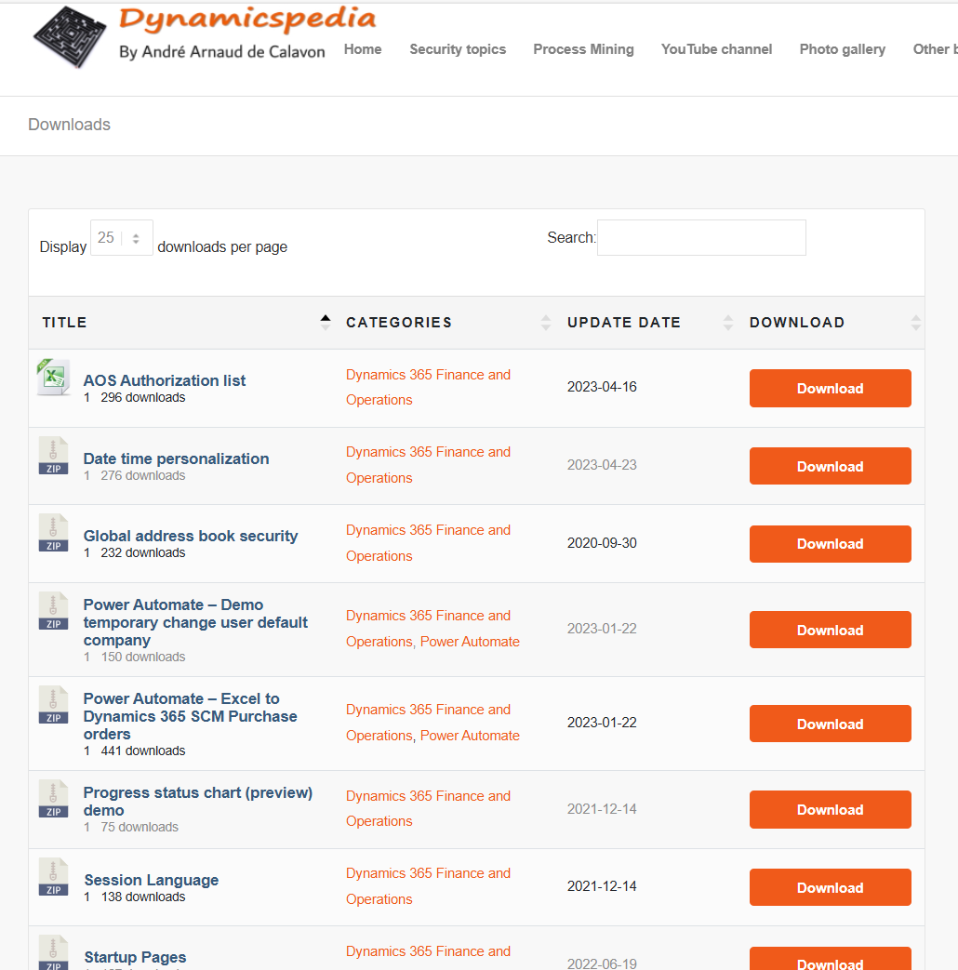
Dynamicspedia by Andre Arnaud de Calavon
Date time personalization
Startup pages
Power Automate – Excel to D365FO
Purchase Orders
https://dynamicspedia.com/downloads/
Notes:
DateTime personalization - gives users more options to manage the format of the date. You can manage the date format where it is setting the month or day on the first position based on your language and date preference setting.

Slide 25
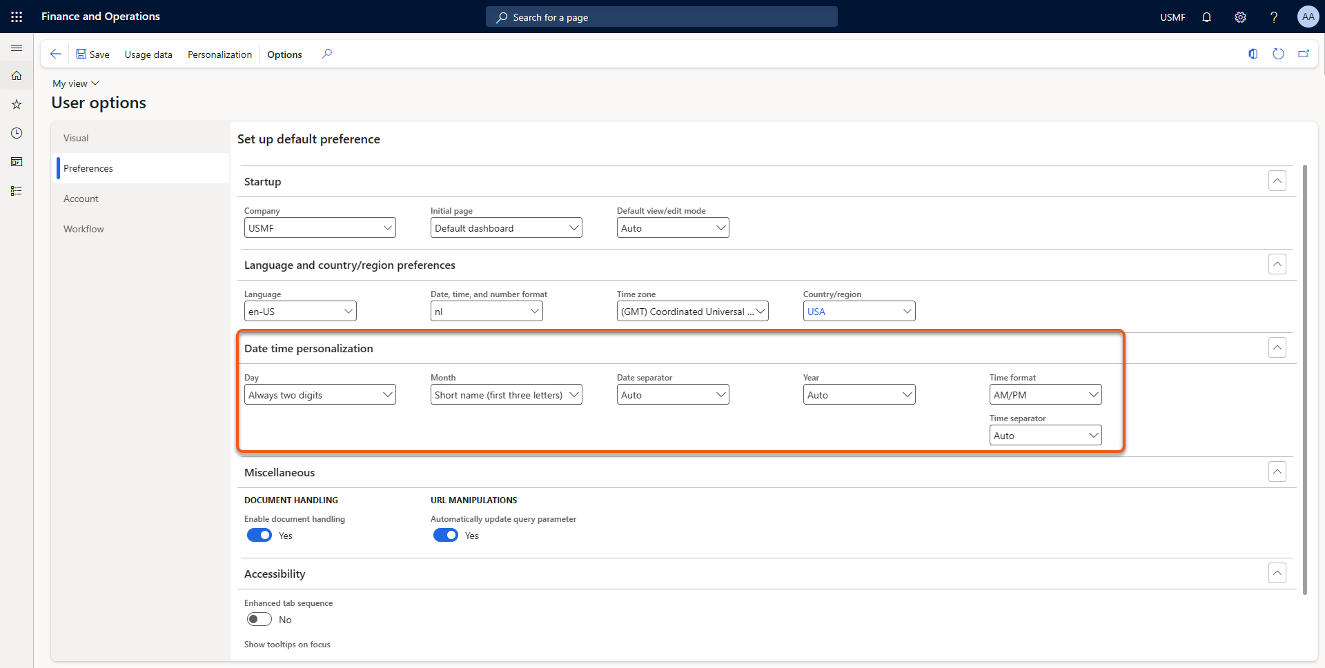
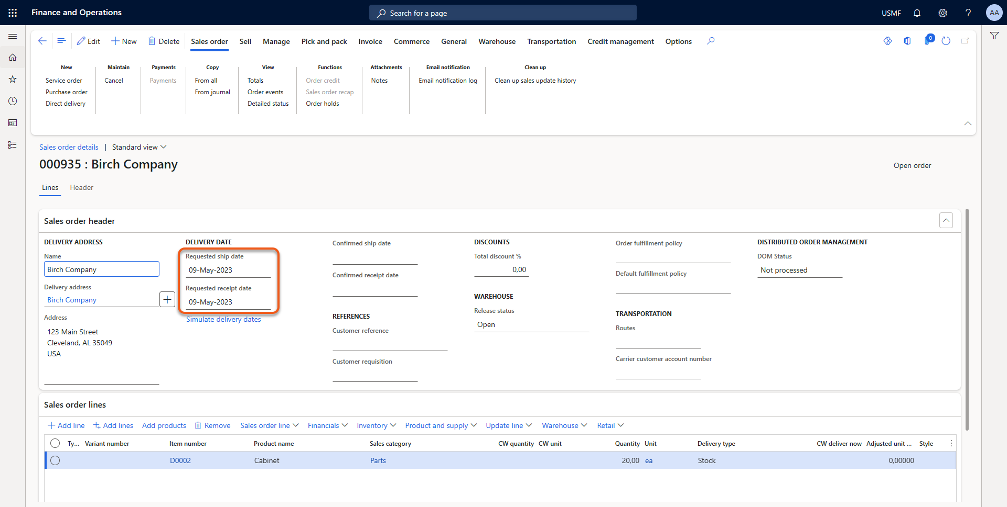

Slide 26
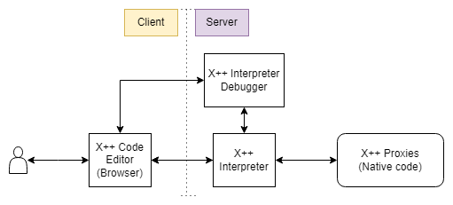
MXT – X++ Interpreter by Oriol Ribes Amenos
Generates bytecode that is later interpreted directly during execution.
Execute, modify and save X++ scripts
Code Editor
Script repository
https://github.com/milnet92/MXTXppInterpreter
Notes:
System Administration > Workspaces> MXT X++ Interpreter

Slide 27
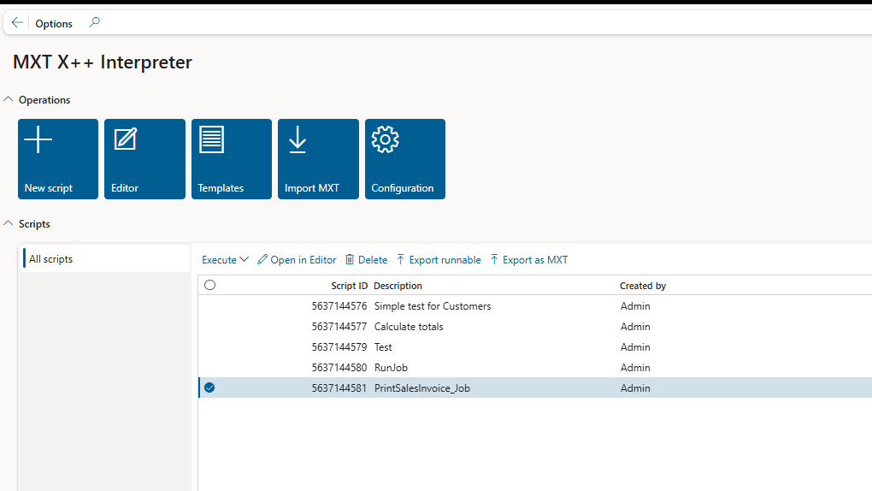

Slide 28
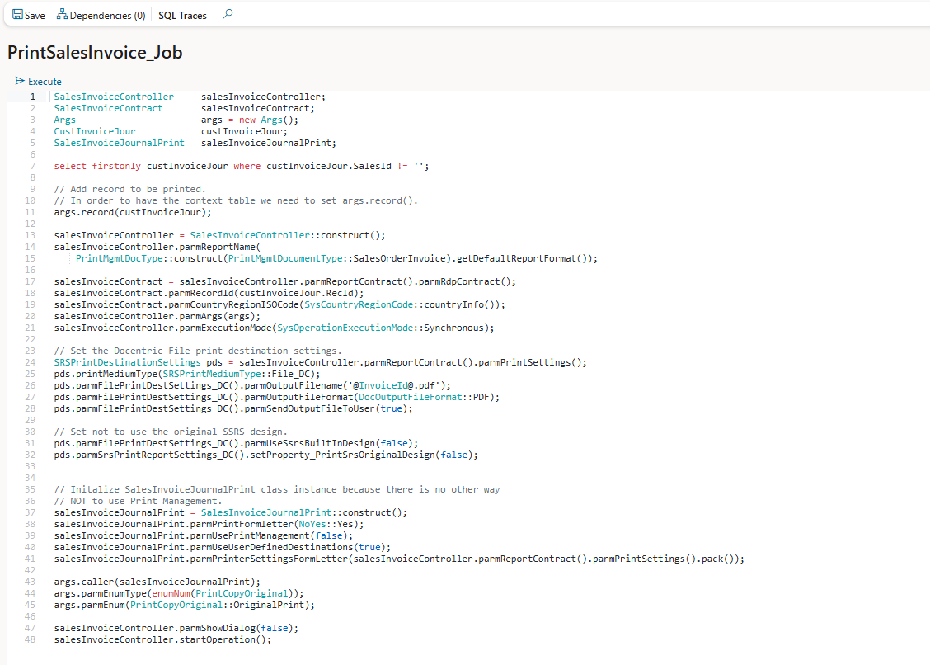

Slide 29
External Admin D365FO tools

Slide 30
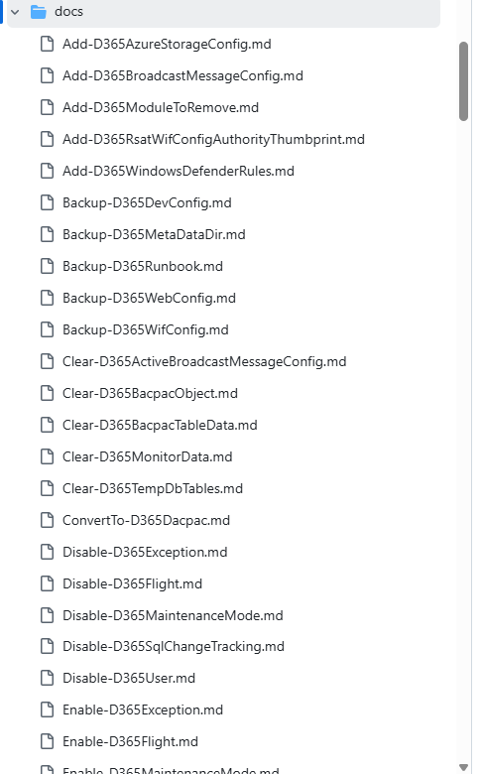
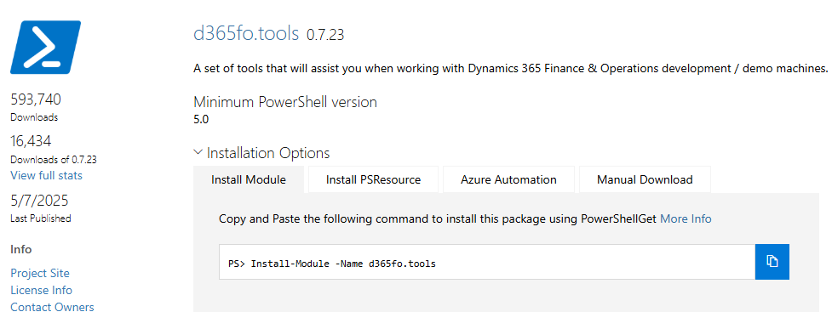
D365FO.Tools by Mötz Jensen, Florian Hopfner
A set of tools/scripts that will assist you when working with Dynamics 365 FO development / demo machines.
https://www.powershellgallery.com/packages/d365fo.tools/0.7.23
Notes:
A PowerShell module to handle different management tasks related to Microsoft Dynamics 365 Finance & Operations

Slide 31
Browser extensions

Slide 32
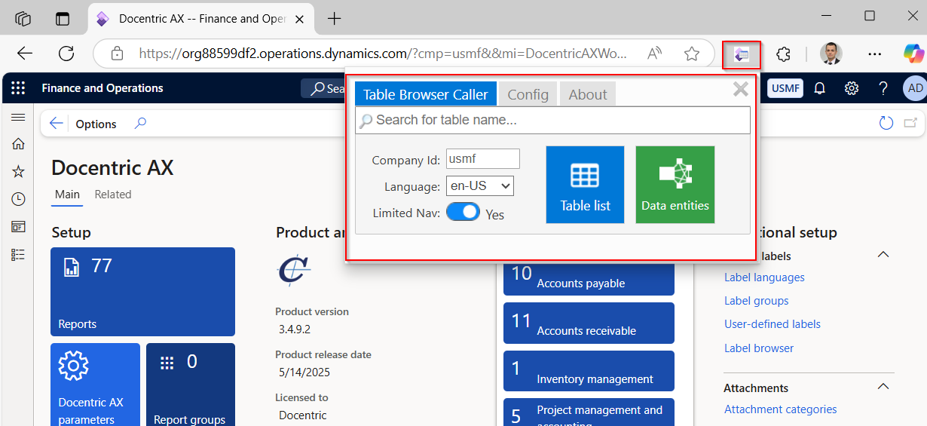
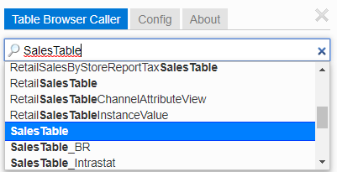
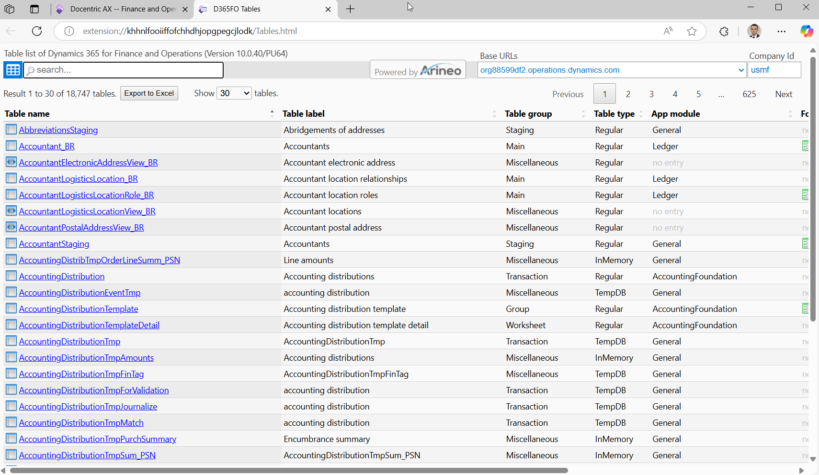
Table Browser Caller for D365FO – extension by Arineo
Notes:
The extension provides a convenient method to list and access tables in Microsoft Dynamics 365 for Finance and Operations (D365FO) via the Table Browser. It simplifies the process of searching for and opening tables in 'table browser mode,' making it an invaluable tool for developers and power users. Additionally, it aggregates and displays a complete list of data entities with fields from an instance. A new feature includes a detailed view for OData entities, presenting a comprehensive list of fields including enum values. Prerequisites: - Access to a D365FO instance. - Adequate permissions to access the 'SysTableBrowser' menu item. The extension comes with a built-in table list. Currently based on D365FO - V 10.0.40/PU64. The table list does not include tables with property 'Visible=No' and deprecated (DEL_*) tables.

Slide 33
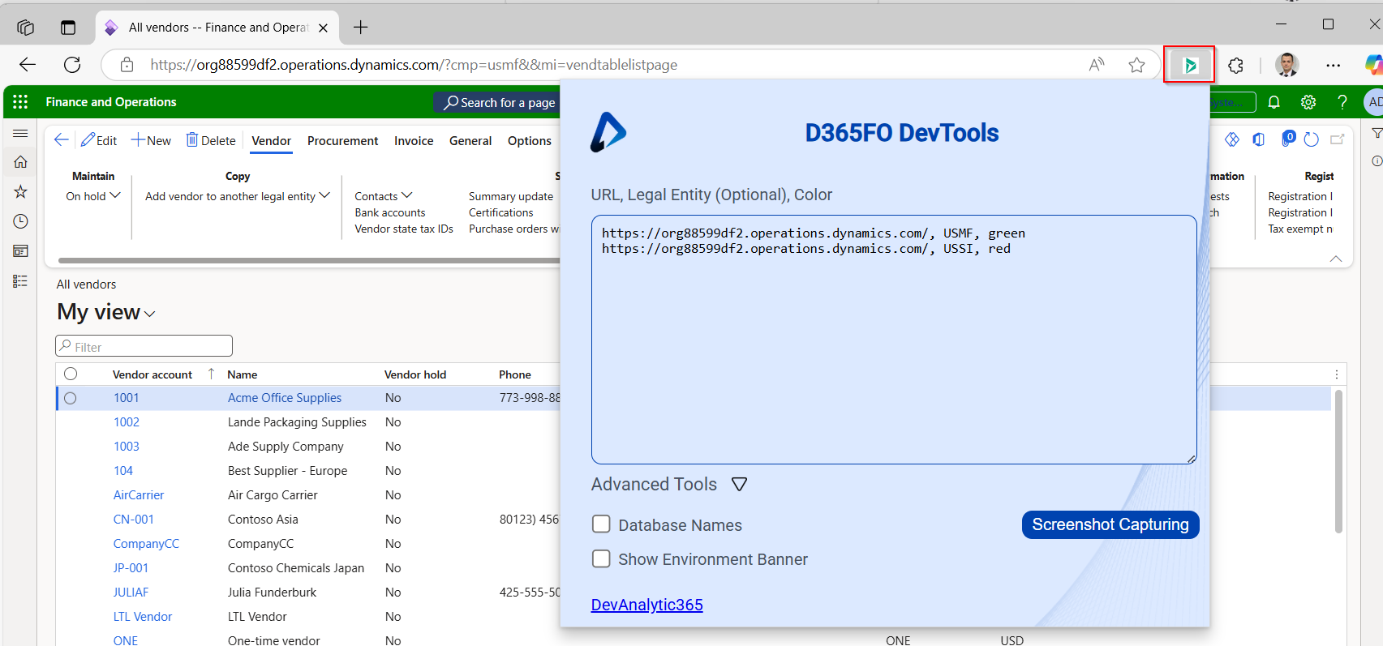
D365FO-DevTools
Notes:
A D365FO Extension that is compatible with Google Chrome and Microsoft Edge, allowing users :
To change the color of the navigation bar per legal entity
To show the database names of forms fields
You can also add screenshot capturing to the task recorder.

Slide 34
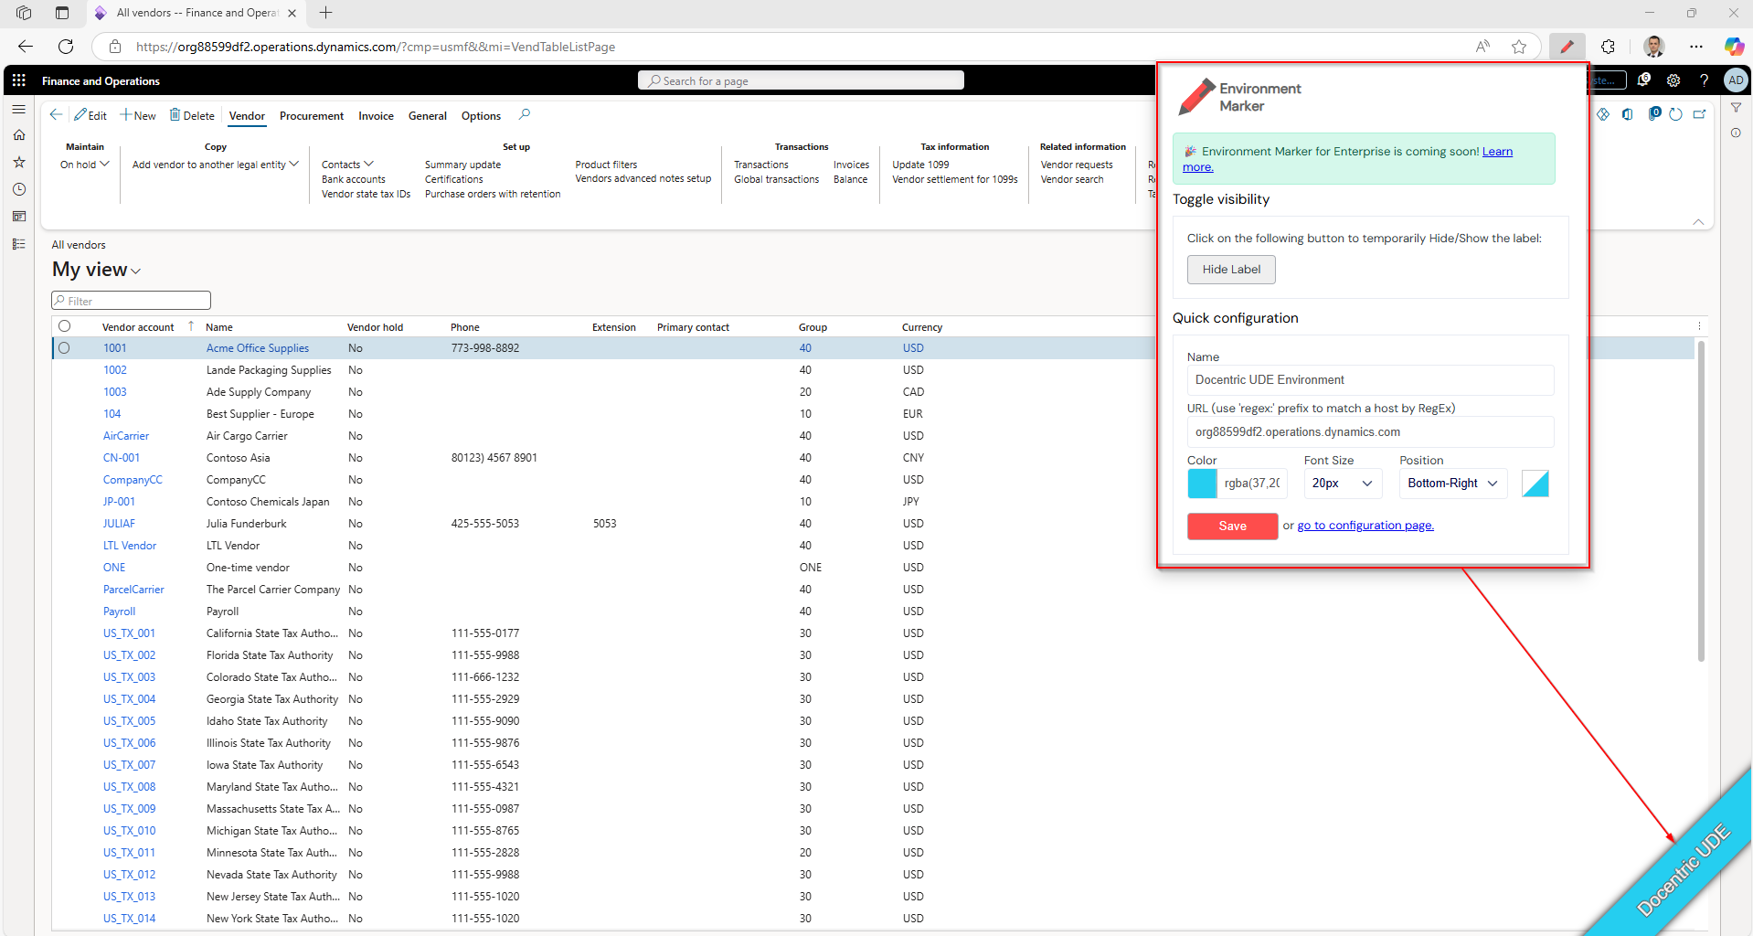
Environment Marker

Slide 35
Docentric Table browser

Slide 36
D365FO Table browser VS Docentric Table browser
Standard
Shows records from table or view in grid
Search, filter and sort data, Export to Excel, create alert rules (“line tables”)
Create, update or delete records in Development environment.
System Administrator
https://<environmentURL>/?mi=SysTableBrowser&tableName=<tableName>
Custom
Create, Update and Delete certain Docentric system tables in UAT and PROD.
Shows TableID and SQL name in the form caption
For each table field Field ID, SQL name and label are shown in the field help text.
Allows searching all tables by Table ID, Table name or SQL name.
https://<environmentURL>/?mi=DocTableBrowser&tableName=<tableName>
DEMO
Example: Use in Document management attachments
Example: Alert rule for PurchLine on Unit filed
Notes:
Utility form that shows records from table or view in grid
However, it is important to realize that the names of each column will be the name of the field of the table. It will not show the ‘label’ property of each field.

Slide 37
Docentric Label browser

Slide 38

Docentric Label browser
Search system labels directly within D365FO – no Visual Studio needed.
Labels added through customization are included in the search.
Search by label ID or translation in selected languages using advanced Find options.
Check existing translations or identify missing ones for any language.
Works faster than the Label Search in Visual Studio
WHY TO USE
No development environment access
Slow or unavailable development environment
Enhanced usability - (VisualStudio labels search limitations)
Notes:
There are some places in FO where you need to know LabelId, for example while you are working with ER.

Slide 39
Label Browser - DEMO

Slide 40
Query browser

Slide 41
Docentric query browser
Improves standard filter form
  Preview data
Custom query
  Export data for further analysis
Notes:
DEMO:
Customer account statement > Records to include > Filter, AccountNum=US-00?, Preview
Exists Join CredManCreditLimitAdvanced (Temporary credit limits)
Copy query SQL (to SSMS)
All customers > Docentric Query Browser
Customer(with email()), ItemId, InvoiceDate for InvoiceDate range (CustTable>CustInovoiceJour>CustInvoiceTran)
Sum of Qty by ItemId and Customer (for InvoiceDate range)
Note that all custom ranges are WHERE, but we plan also ON option

Slide 42
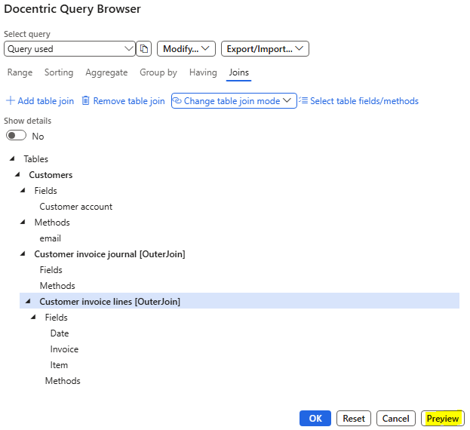
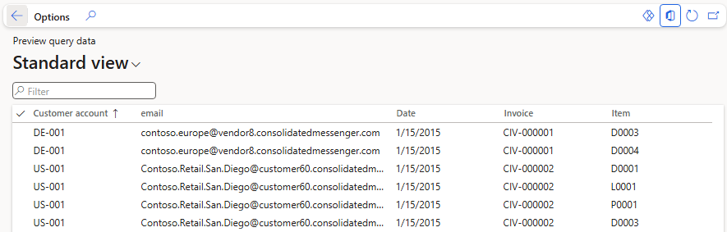
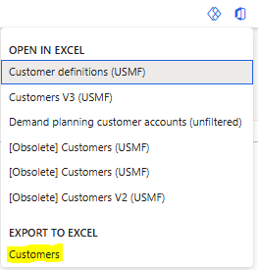
Docentric query browser
Example:
Invoice lines with customer email
Shape the data and export result to Excel

Slide 43
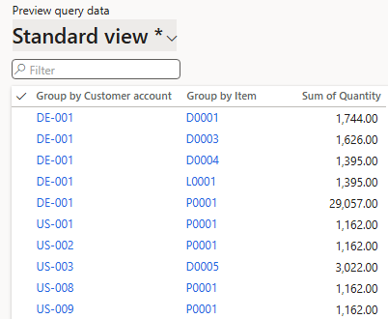
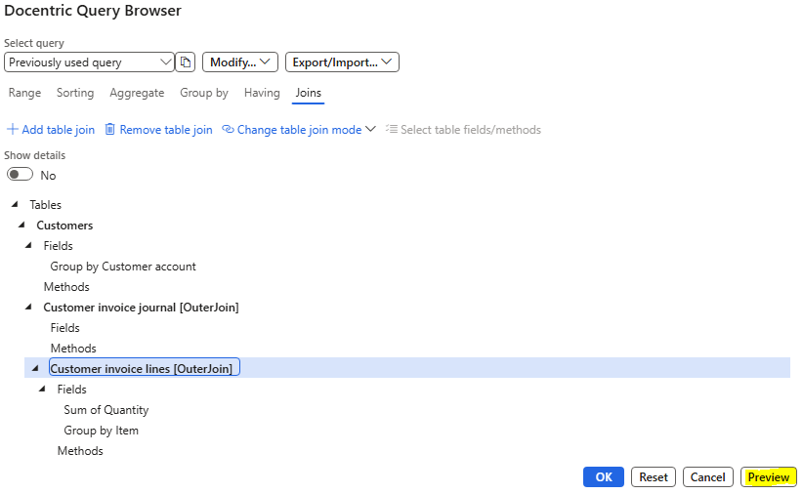
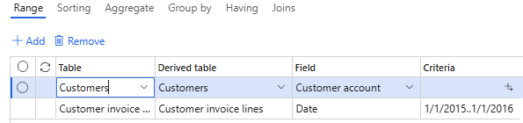
Docentric query browser
Example:
Total item quantity for a given year grouped by item and customer

Slide 44
Batch job alerts and export log

Slide 45
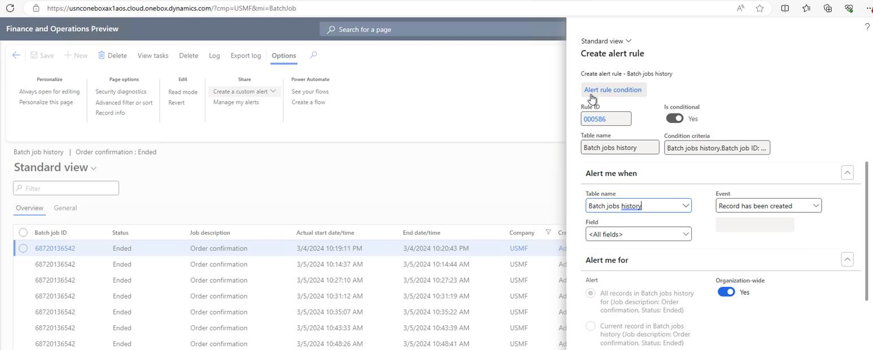
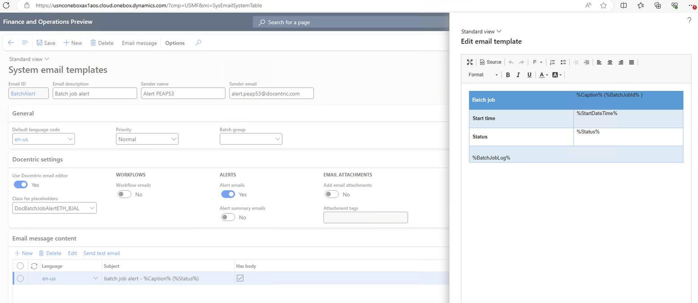
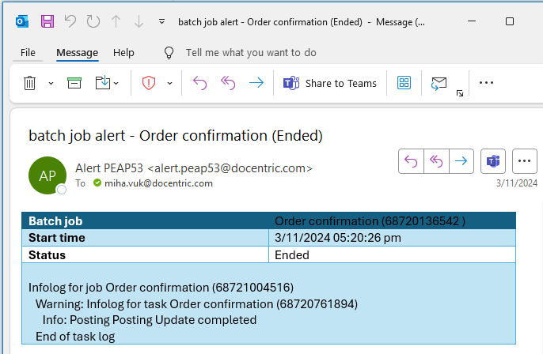
Batch job alerts

Slide 46
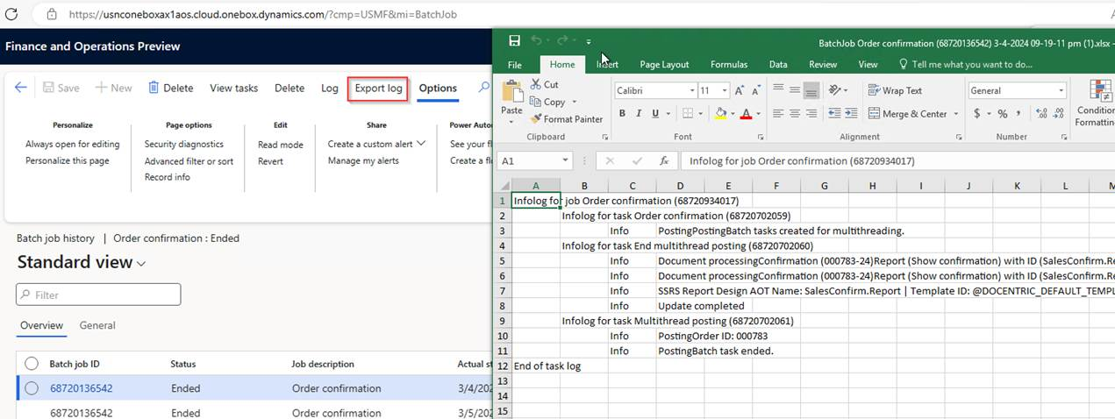
Export batch job log
Standard prints log to infolog and truncates at 10000 lines
(“The number of messages exceeds the limit of the Infolog (10000.)”)
With Export log you export full log in Excel where you can easily search for errors
Notes:
DEMO: TODO

Slide 47
Security precautions
Some tools
  Give easier access to existing functionalities
  Give non-standard access to the data
  Can change the data in non-standard way
Some tools are super powerful, but can make super damage
All shown tools are safe, but some only if used appropriately.
ALWAYS TEST ALL INVASIVE ACTIONS
BEFORE EXECUTING ON PROD
Notes:
Risky, but ONLY if used inappropriately. Do not give it automatically to all business users, not even to all admins.

Slide 48
Summary
Productivity tools
  Embedded D365FO tools
  External Admin tools
  Browser extensions
  Developer tools
Our contribution (Docentric Free Edition):
  Table, Label, Query browser
  Batch job alerts and export log
Security precautions
Why we developed it
SO, WILL YOU USE IT? 🧐🙄

Slide 49
QUESTIONS?
JOVICA ŽIVKOVIĆ
jovica.zivkovic@docentric.com
linkedin.com/in/jovicazivkovic
MIHA VUK
miha.vuk@docentric.com
linkedin.com/in/mihavuk

Slide 50

THANK YOU!

